Slide 1
Game analysis and season strategy
With Justin White

Slide 2
Preface
The Content of this presentation is all based on experiences of myself and my team. This is what works best for us. Not every bit of it may work the same for you or your team. Take any info provided and use or modify it as you see fit. What works best for one team may not work best for every team.

Slide 3
Purpose
Defining a successful season
How to accomplish that
How to improve season to season
Notes:
So what is the purpose of this presentation? Its to answer these 3 questions, What does a successful season mean to you? How does one accomplish a successful seson? How do you get better from year to year? This section will tell you how to answer these questions, and then we will go into depth on providing better answers in the rest of the presentation. A lot whats in this presentation helps drive mechanical design for an individual season, which is why David and I are doing these two presentations in tandem.

Slide 4
Defining a successful season
Evaluate yourselves, and be honest.
Set goals
Goals drive strategy, strategy drives design, performance targets drive improvement
Remember, a successful season is different for every team.
Notes:
Acknowledge where your team currently accels, and where you are falling short. Things like programming, design and manufacturing ability. If you are a rookie team you may not know this yet. And that’s ok.
Set goals based on this evaluation. What do you want to accomplish that you haven’t before. Always aim higher, but don’t aim too high all at once or youll likely fall short, not only of those goals, but of your past as well.
For one team it may be winning events, or advancing to worlds. For another team it may be making playoffs and advancing to dcmp. Some teams, winning a single award may be considered successful. Define what this is for your team. This all depends on what your goals are

Slide 5
How to accomplish a successful season
Preseason
Training
Self evaluation
Recruiting
Post kickoff
More goals!
Effective strategy based on game and design/manufacturing abilities
Build/competition season
Complete your build goals before making more. But always be improving. Never stop innovating.
Pros and cons
Notes:
Now is too late for this part, but good to note for the future. Preseason i typically consider to be around when new school years start. So august until December. Recruit your new students, train them, then evaluate your teams position in December. Make your goals for the season. Goals drive strategy, strategy drives design, and performance targets drive improvement set some goals to have things done by a certain point, a “standard” goal is two weeks for design, two weeks for build, and two weeks for practice. This is rarely accomplished by anyone but its not a bad starting point. Once you have finished your first design and can start practicing, then you can find flaws, make changes or improvements. But its important to have a working robot first and be ready for competition, even if its not with those improvements yet.
do a pros and cons list after every event. Find what you can improve on. Our team gathers all together after an event and get a big white board and we review what went well and what could be better. Then we discuss how to improve the cons going forward.

Slide 6
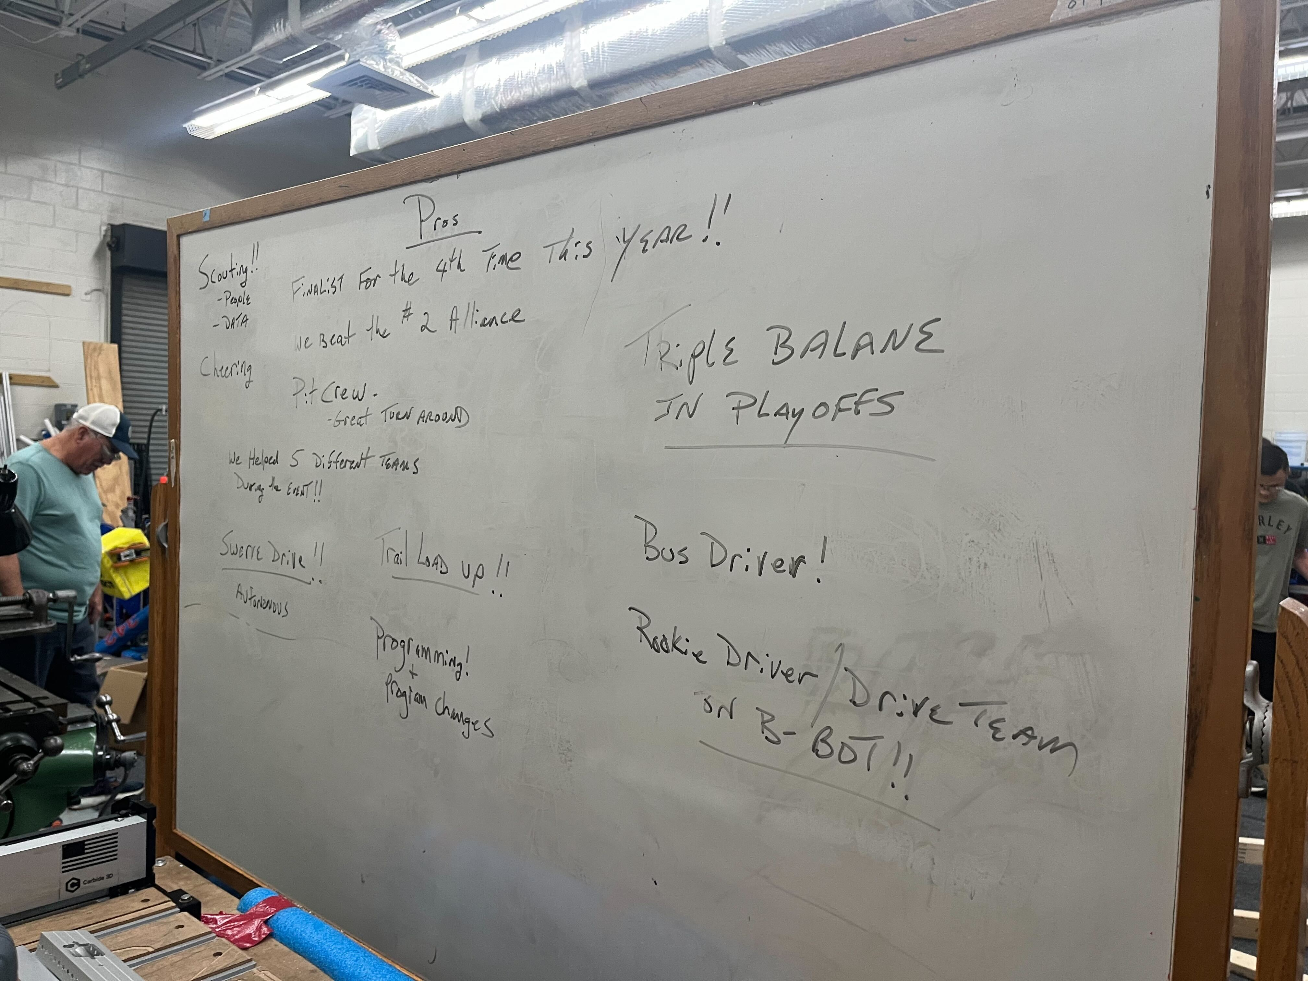
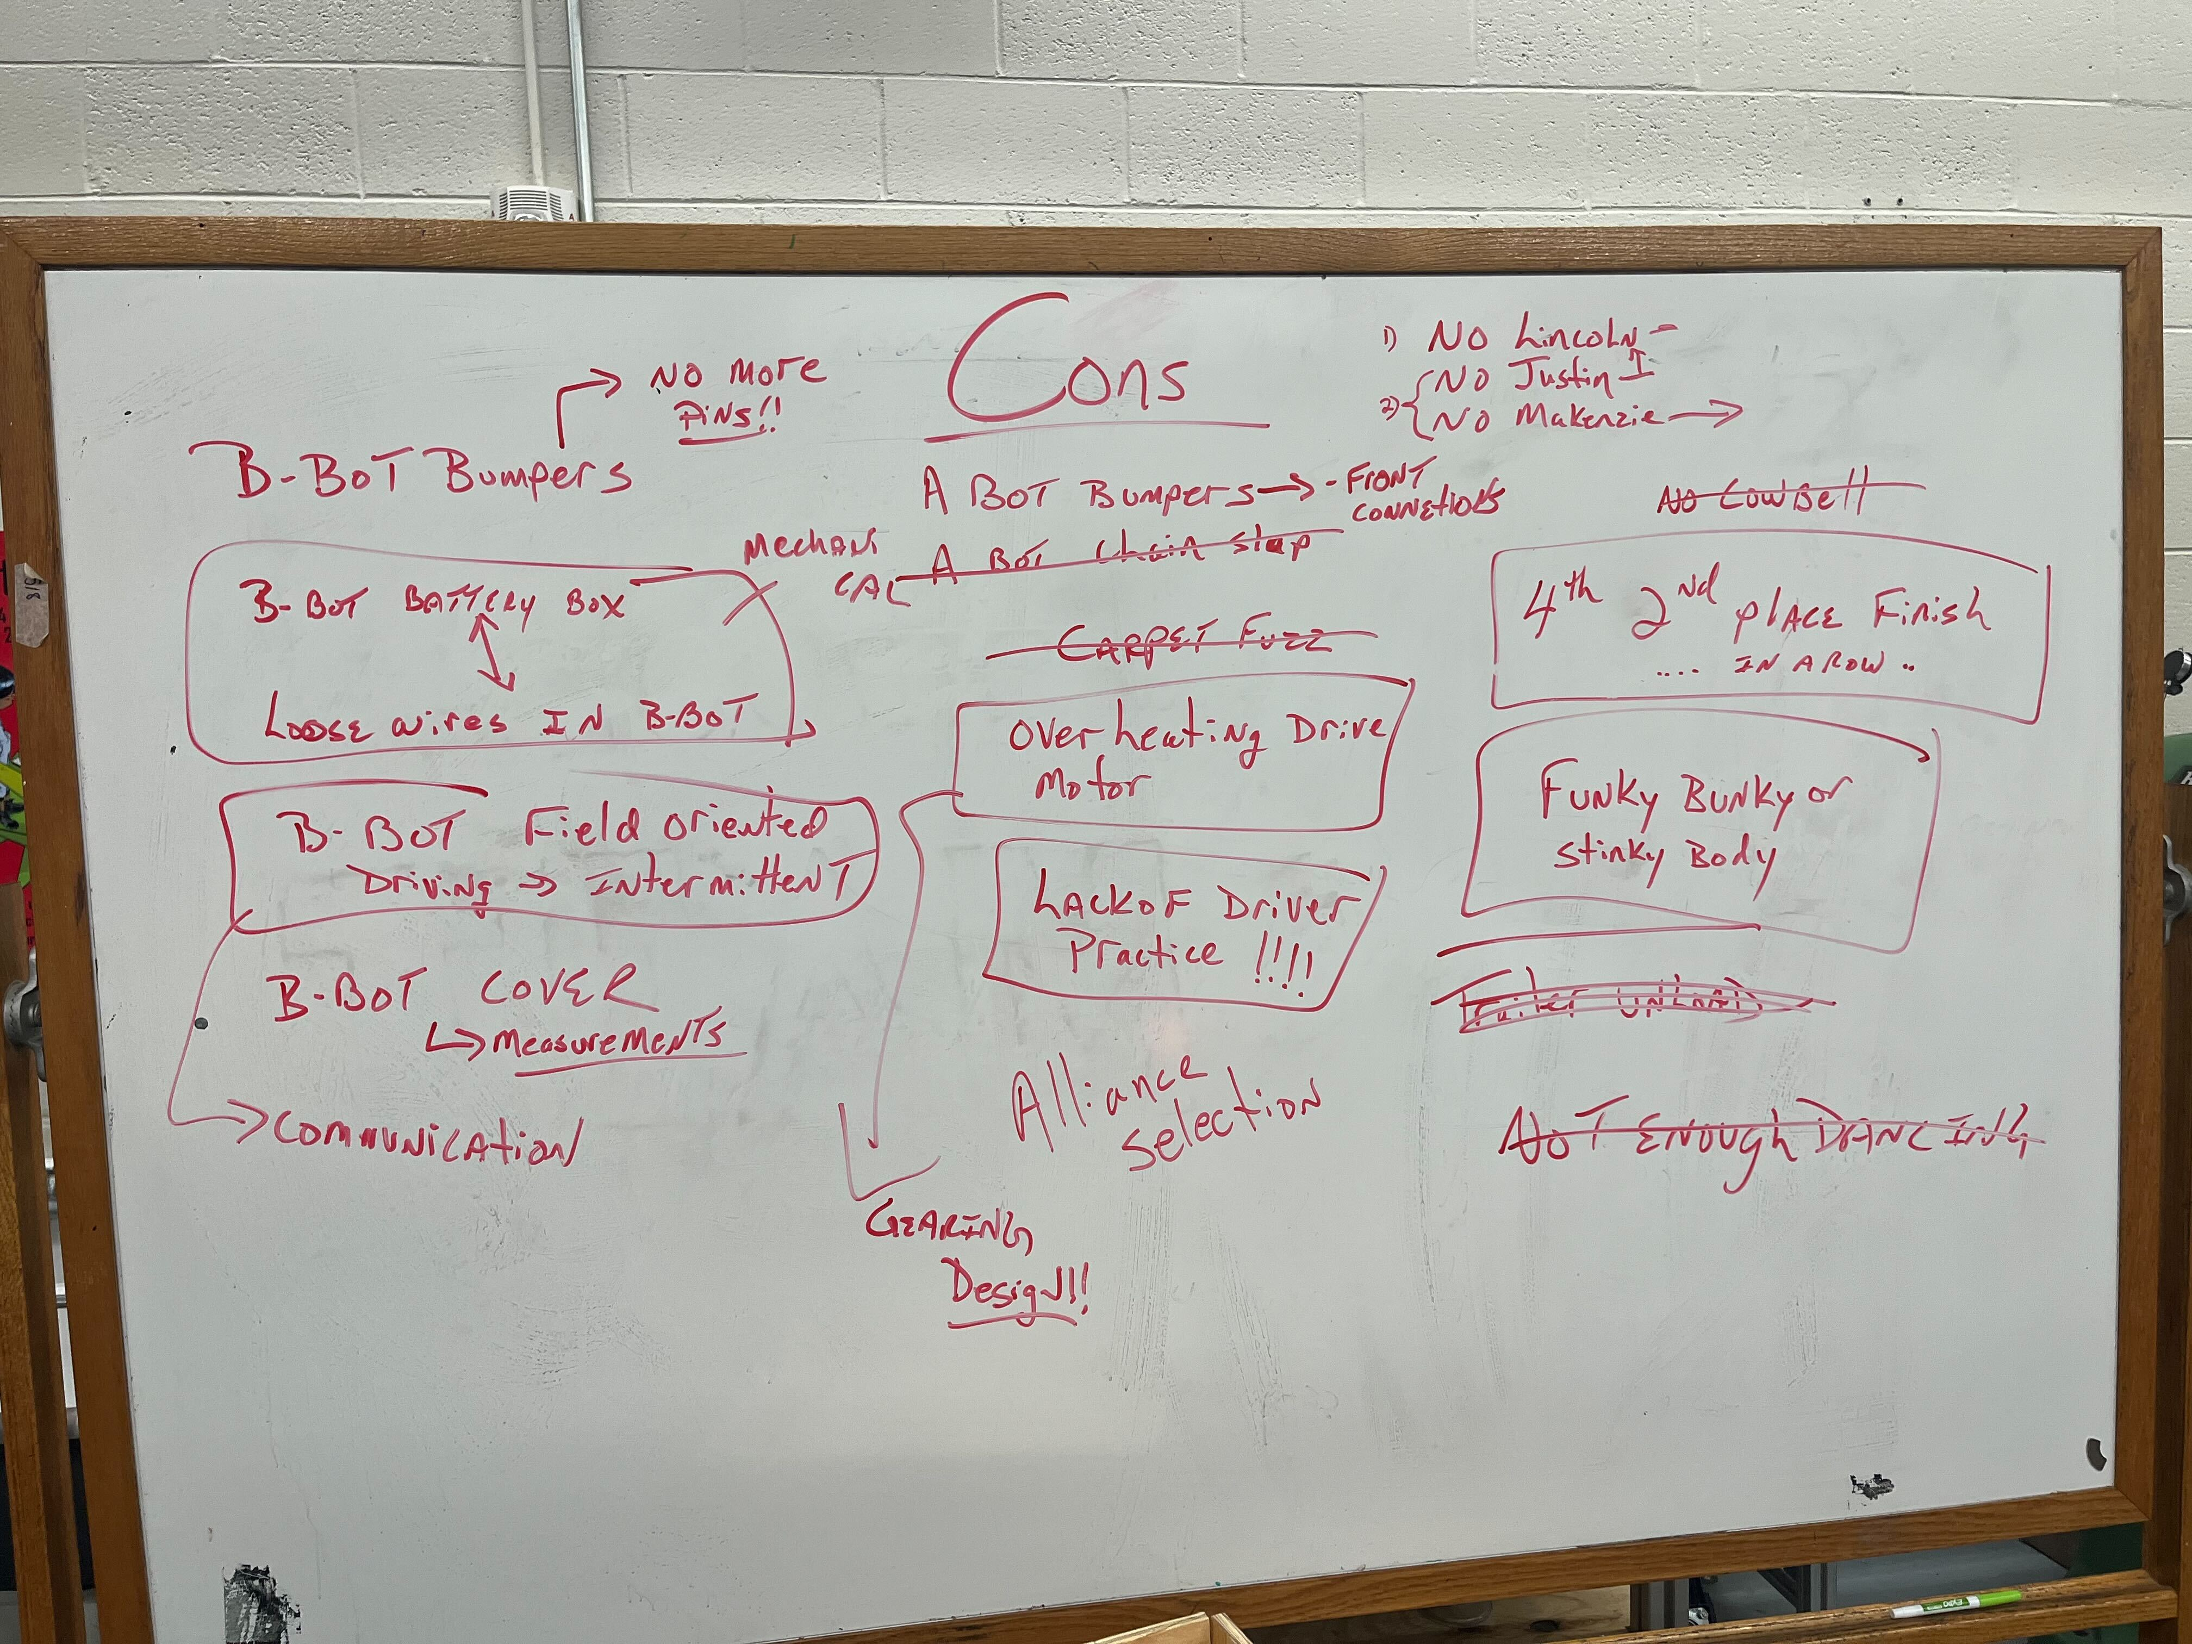
How to improve season to season
Pros and cons
Learn from mistakes
Explore new things during the off season
Notes:
Do pros and cons after every event, and at the end of the season.

Slide 7
Season Strategy
Preseason
Kickoff day
Kickoff week
Build season
Competition season
Beyond
Notes:
This section is a strategy for having an effective season, and less about specific game or robot strategy.

Slide 8
Preseason
Training and recruitment
Self eval
Season goals
Prepping
Cleaning and organizing
5S, (translated from Japanese) Sort, Set in Order, Shine, Standardize, Sustain
3D Printing (hex spacers, gear box covers, helpful tools, Jigs, etc.)
Ordering COTS parts and materials (hex shaft, tubing, motors, gearboxes, etc.)
Notes:
We talked about this earlier, but do your recruiting, training, and self eval before the season starts. Set some season goals, like winning an event or making it to DCMP do some prep work. Use 5S principles to organize your shop. Print some stuff that can maybe take a while to print or are commonly used. You can also print prototype parts that don’t need to hold up to competition, like motor mounts or spectrums proto-pipe system pre order commonly used parts, stock and materials, expendables like nuts and bolts, COTS Kits like swerve modules or elevator kits.

Slide 9
Kickoff day
Game review
Know all elements of the game, relevant rules, etc.
Discuss, don’t decide, what elements of the game you hope to accomplish.
Needs, wants, nice to haves
Decide drivetrain
Decision matrices
Notes:
Not ever member of the team needs to know every rule. For example, build and design team likely don’t need to know if you can drive into the opponents loading zone or something. But they do need to know how far your robot can extend beyond frame perimeter
Remember your season goals, and your self eval. Make your needs, wants, nice to haves based off this. You may only need to do one thing really well to accomplish your goals. For example, in this previous season, you may only need to do cubes to perform well, like 4451’s cube robot at SCRIW. We will discuss these more in depth later.

Slide 10
Kickoff week
Decide elements of the game you want to complete
Discuss ways to accomplish this
Prototype
Make design direction decisions, keep prototyping afterwards to improve your design.
Notes:
After you have your needs and wants, begin brainstorming and prototyping. Later in the week you should decide which prototypes to pursue. Begin working on these designs, but keep prototyping these concepts to improve them. Such as trying different wheels on an intake, or hood angles on a shooter.

Slide 11
Build season
Program along side build.
Drive practice!
Never stop innovating
Robot appearance comes last. It should NEVER be a priority.
Notes:
While design and build is occurring, programming can test on old robots and test beds.
Drive team can practice with old robots, they should be responsible for keeping up with rules updates. Remember, well practiced drive team can take a mediocre robot far. Or as Dale Earnhardt said, anyone can drive a good race car, it takes talent to drive a bad one.
These two are self explanatory. I thought about putting some pictures of robots here but in the interest of gracious professionalism I figured best not to call out specific teams, even if they aren’t ones we compete with.

Slide 12
Competition Season
Minor changes and fixes
Plan ahead for big changes
DRIVE PRACTICE!!
Pros and cons
Sun | Mon | Tue | Wed | Thu | Fri | Sat
 |  |  |  |  | Week 2 Comp
 | Prototype and Design new mechanism
Build it |  | Build it |  |  | Week 4 Comp
 | Install |  | Test, program, practice
Practice! |  |  |  |  | DCMP
Notes:
Small changes can happen between one event
Bigger changes take more time. Make prototypes, make a final design, build it, attach on the first day back from an event so you have more time to test and practice with it. Now you have a full robot. Drive team needs to practice on it as much as possible. This not only gets them practice time, but helps find ways to improve, and failure conditions. As stated earlier, pros and cons.

Slide 13
Competition Prep
Roles
Pit Crew, Scouting, Drive Team, Strategy
Check lists!
Spares
Mechanisms, Parts, Materials, Kitting
Practice!!!!!
Driving, Strategy changes, Repairs, Scouting

Slide 14
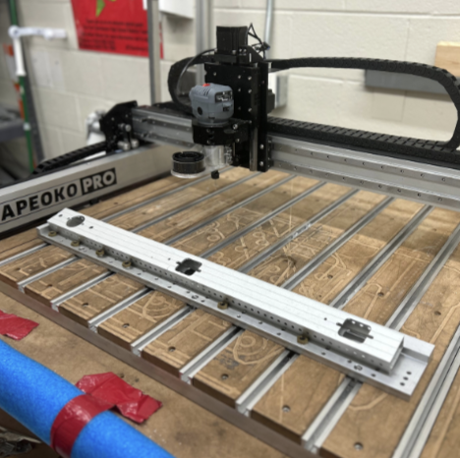
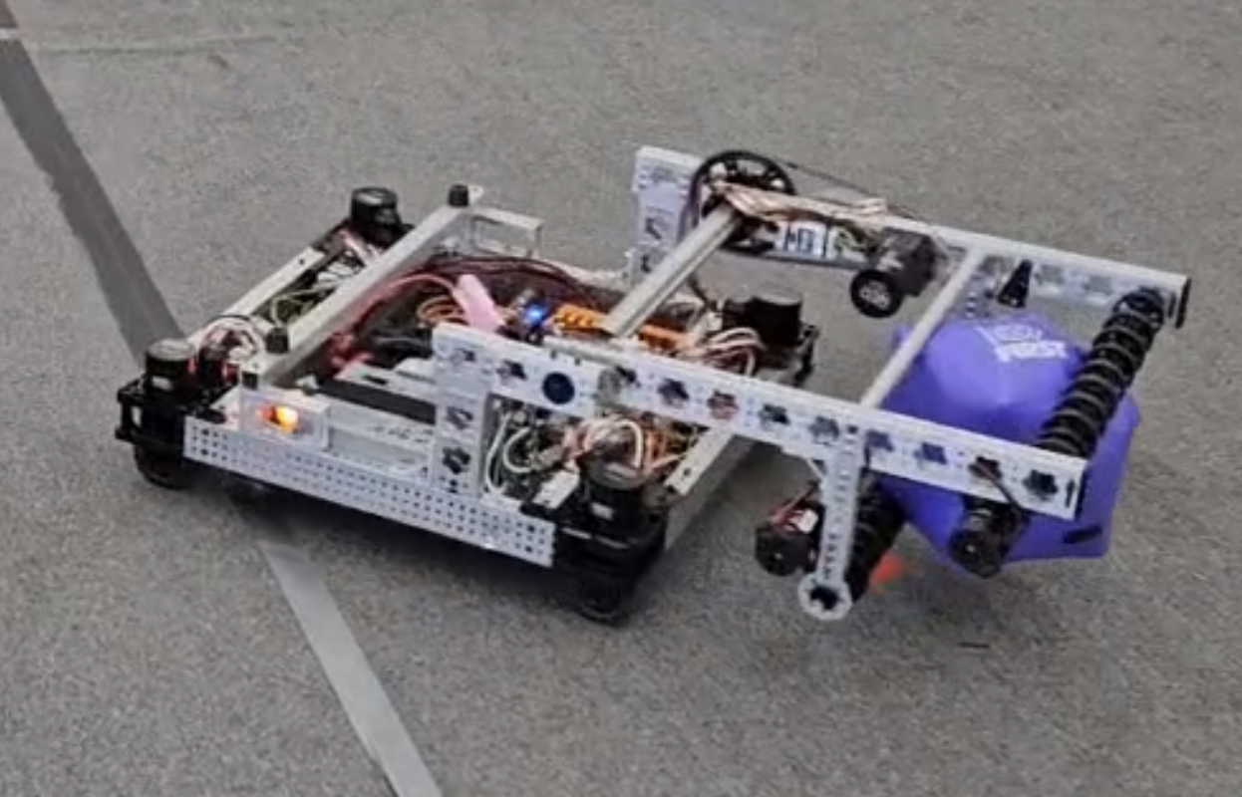
Beyond
Try new things (swerve, turrets, auto programs)
Invest (machinery, software, training)
Outreach, sponsors, recruitment
Notes:
Off season is the time to try new things. Things this season you saw others do that you thought, “theres no way we could have done that this year” or things on your nice to haves list from before. Invest time and money. Buy new tooling and machines like cnc routers, get used to how they work in the off season. Train yourselves on new softwares or machines. Do more outreach. Recruit sponsors, mentors, and students

Slide 15
Game analysis
Rules
Elements of the game
Design decisions
Golden Rules
Notes:
Now, finally, we’ll discuss how to decide your game and design strategy by analyzing the game.

Slide 16
Rules
Know the “evergreen” rules before kickoff
Learn the basics of the season
Really learn the important ones to your sub-team
Notes:
Evergreen rules are rules like “don’t tear down opponents to bring yourselves up”, or don’t enter the frame perimeter of another robot, the Pinning rules,

Slide 17
Game elements
Layout the different parts of each game,
Game pieces, methods of scoring, auto, telop, endgame
Determine the value of each
Build your strategy off of a few factors
Value of game elements
Team capabilities
Season goals

Slide 18
Design decisions
Your strategy drives your design
Needs, Wants, Nice to have/Ideas to explore
Dynamic lists, Decision matrices
Scoring | Needs | Wants | Explore
 | Score Cones & Cubes | Score Both all 3 levels | One mech for both
 | Easily drive on bridge | Auto balance | Position locks
Chassis Decision
 | Tank | Mecanum | Swerve
Pros | Not slip. Familiar. | maneuver. Familiar. | Maneuver, no slip,
Cons | Less maneuv. | slippy | No familiar, complicated
Gripper | Needs | Wants | Explore
 | Hold both Pieces | Also be the intake | Serialize cones?
Notes:
Goals drive strategy, Strategy drives design, performance targets drive improvement
These lists should be ever changing. Ours start with just scoring, what do we need to score, as in what game pieces if there are multiple, or end game scoring. Then how do we score those game pieces, what levels like high medium and low if those exist. They evolve to specific robot parts for manipulating those game pieces or end game scoring, and again, high medium and low if they exist. Then we may have specific sections for autonomous or driver assists. If something from your nice to have lists becomes viable, explore it more with its own needs wants and niice to haves list.

Slide 19
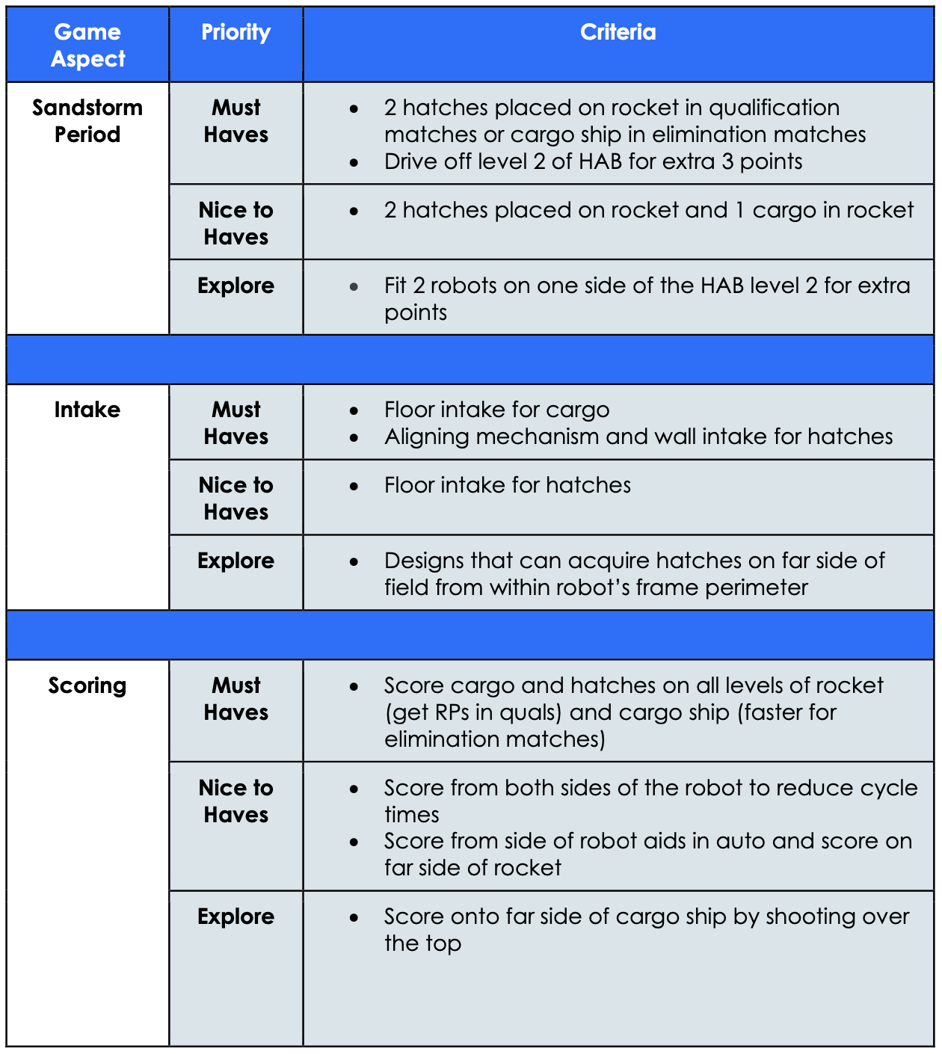
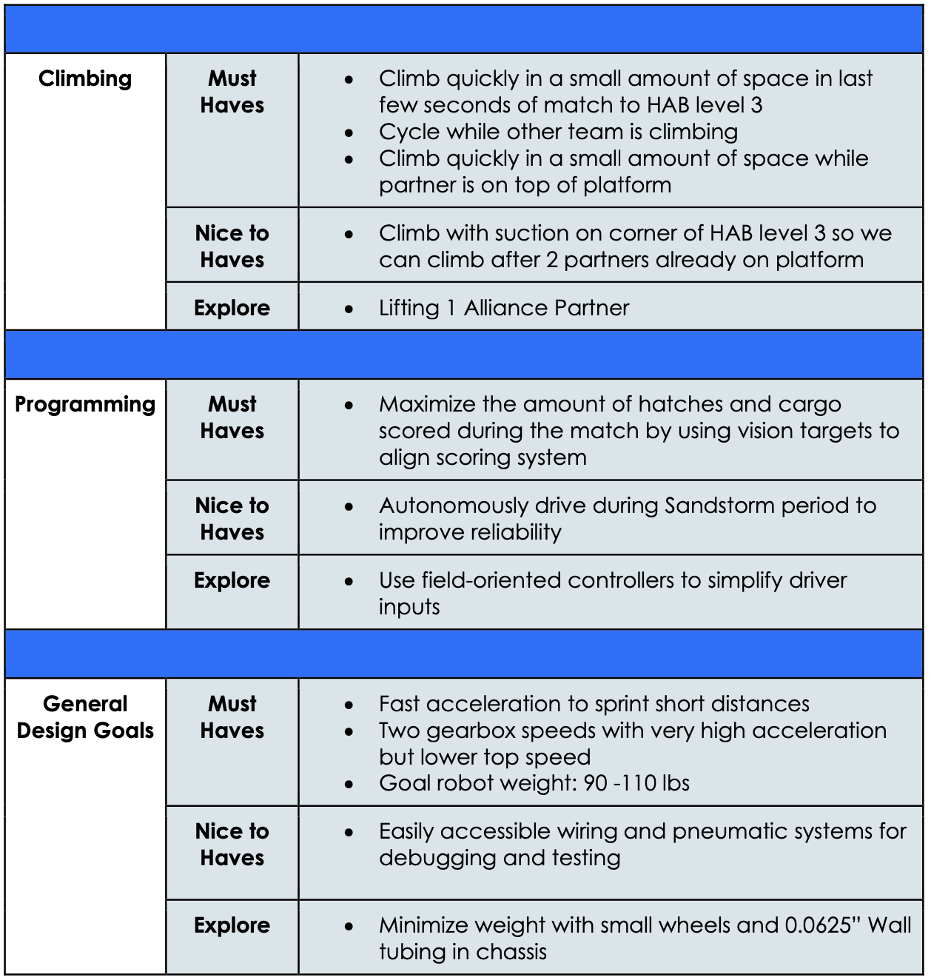
Needs, Wants, Nice to have
A more advanced example from 254..

Slide 20
Golden rules
Keep It simple
Build within teams capabilities, simple=robust, function over form
Steal from the best, invent the rest
Learn your history, watch Ri3D teams in season
Use Proven (for you) Drivetrains
Lets you focus more on mechanisms (for us, tank, mechanum)
Remember the drivers
Make it easy, large acquisition zones
Fail Fast
Test/prototype your ideas asap, find problems, iterate or change design

Slide 21
Wrap Up
Define what success is to you, set goals, know your limits
There’s always something to improve on
Have a plan, but be flexible
Remember the golden rules

Slide 22
Questions?
Feel free to reach out,
whitejustin342@gmail.com
Red Leader 342 on Chief Delphi

